Slide 1
Project TITLE:
NBA Draft Combine Measurements Analysis
Presented by:
Shriyansh S Mishra

Slide 2
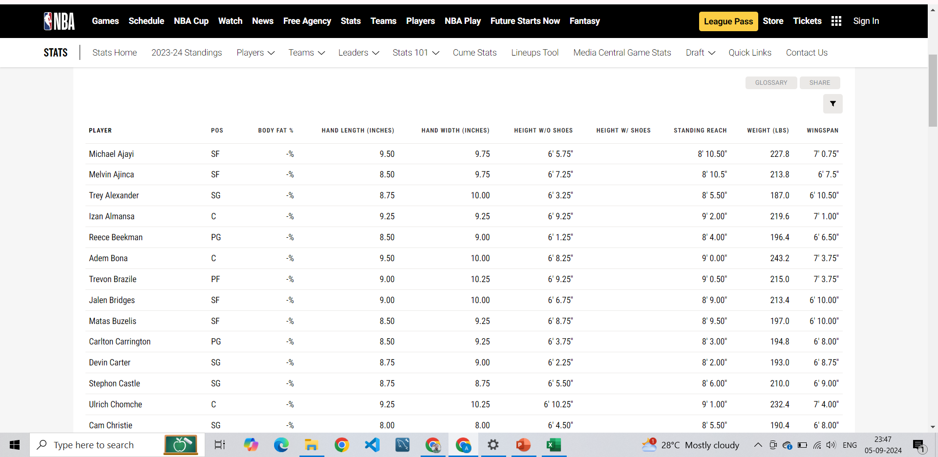
Project Overview
The goal of this project is to analyze NBA Draft Combine measurements to uncover patterns and insights. These measurements, which include player height, wingspan, weight, and other physical attributes, help in predicting player success in the NBA.

Slide 3

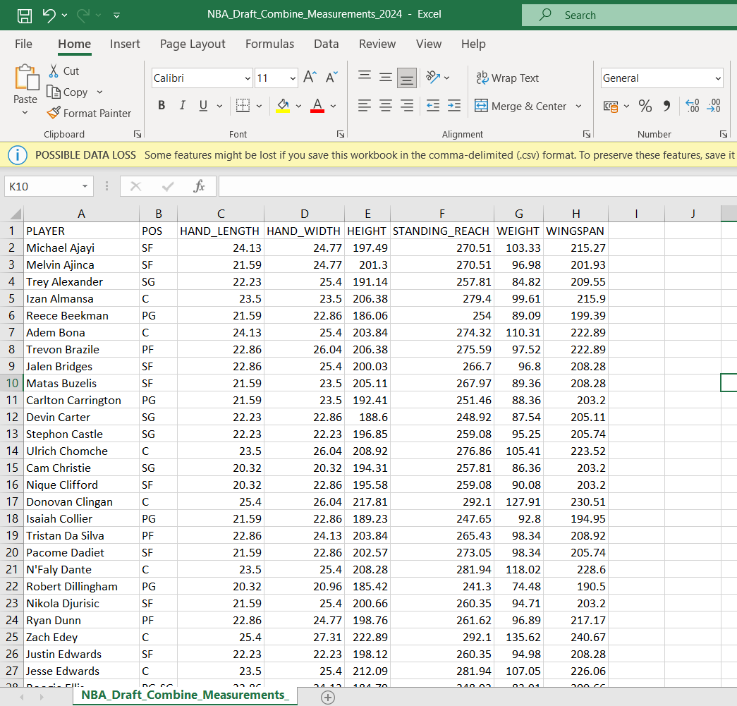
Dataset Summary
The dataset includes measurements of 80+ NBA draft players. Key attributes analyzed include
Hand Length
Hand Width
Height
Standing Reach
Weight
Wingspan

Slide 4
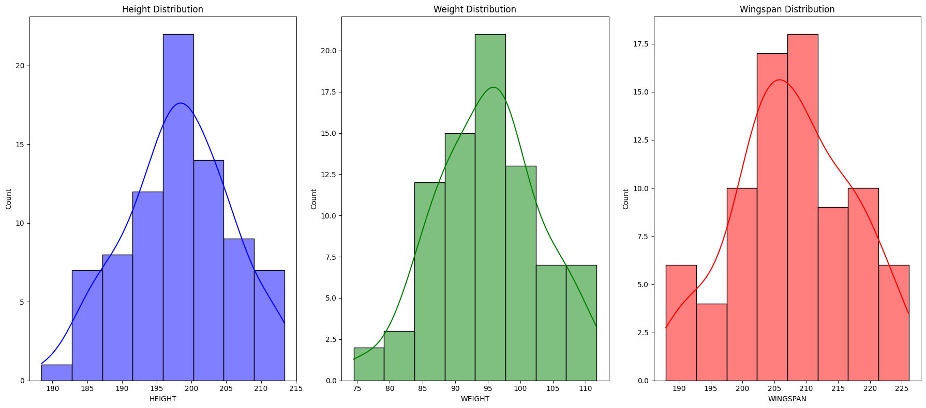
Descriptive Statistics
We performed descriptive analysis to understand key measurements:
Average Height: 201.5 cm
Average Weight: 94.1 kg
Average Wingspan: 209.3 cm
This allowed us to observe the general physical characteristics of players in the draft

Slide 5
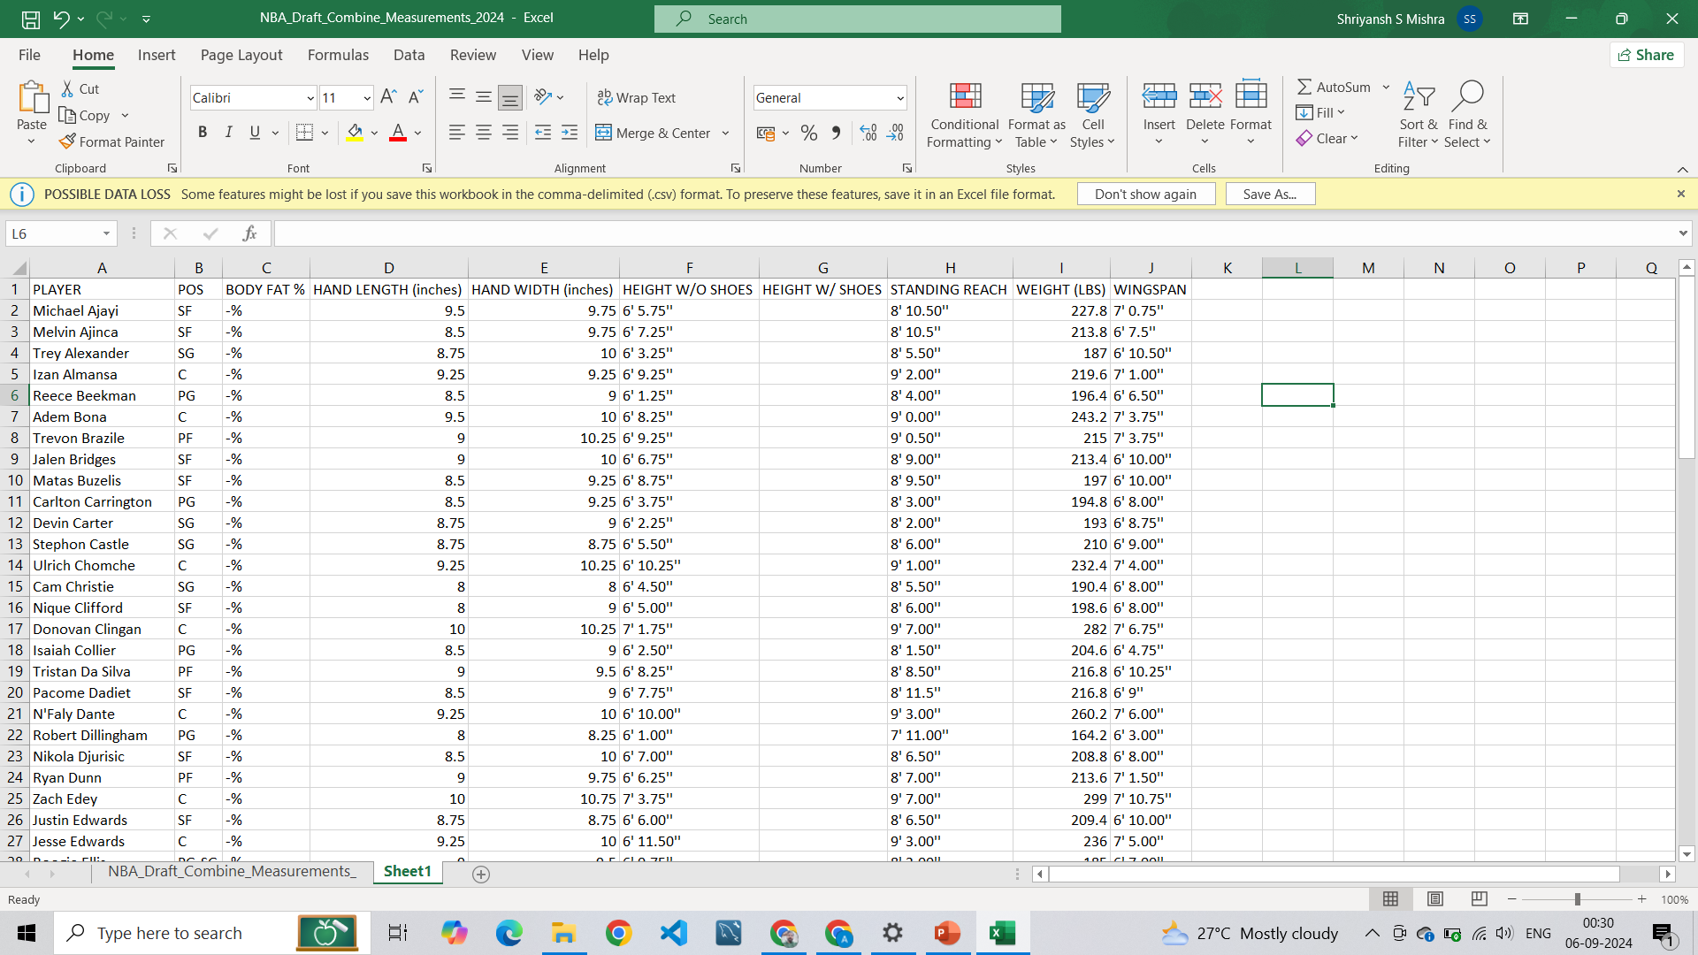
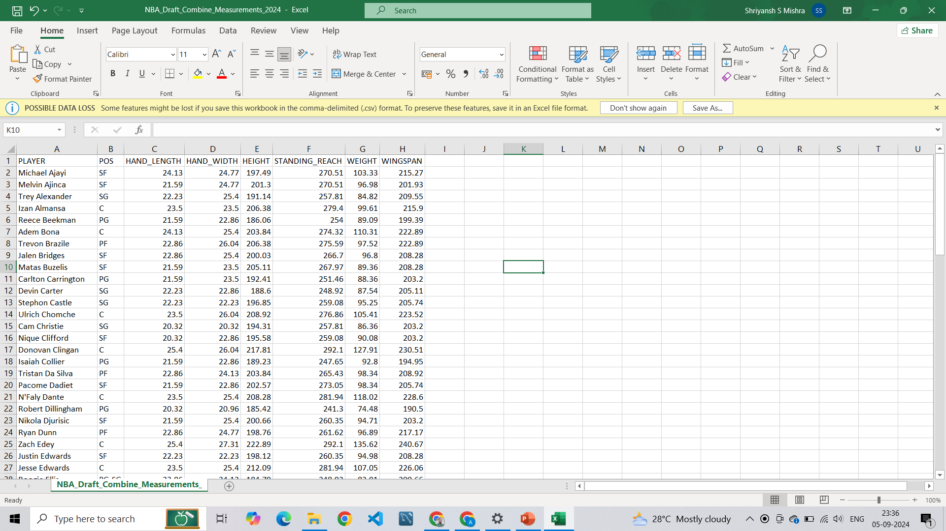
Data Cleaning Process: We identified inconsistencies in the data format, particularly in the height and weight columns. The following steps were taken to clean the data: 1. Converted height from feet-inches format to centimeters 2. Converted weight to kilograms 3. Removed any potential outliers .
Before Data Cleaning
After Data Cleaning

Slide 6
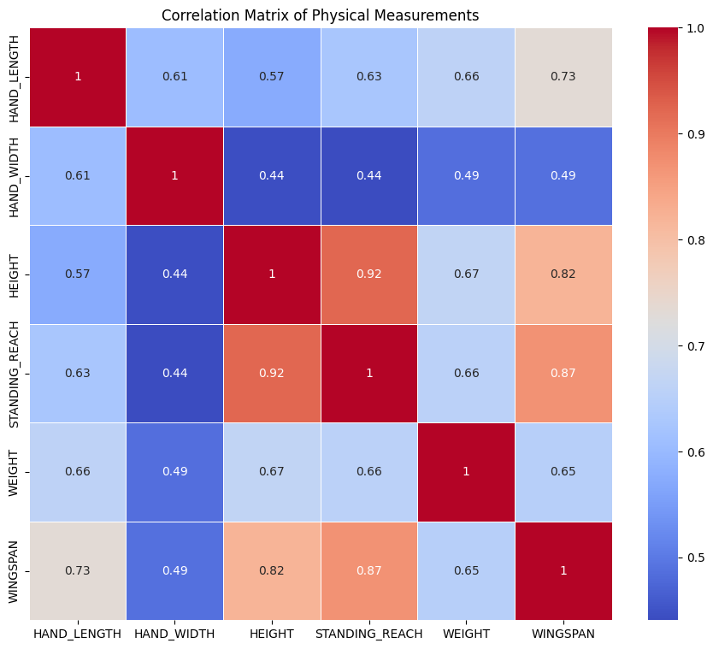
Correlation Between Measurements
We calculated the correlation between different player measurements. Strong correlations were observed:
Height and wingspan show a correlation of 0.82, indicating that taller players tend to have longer wingspans.
Height and weight had a correlation of 0.67, suggesting that taller players generally weigh more

Slide 7
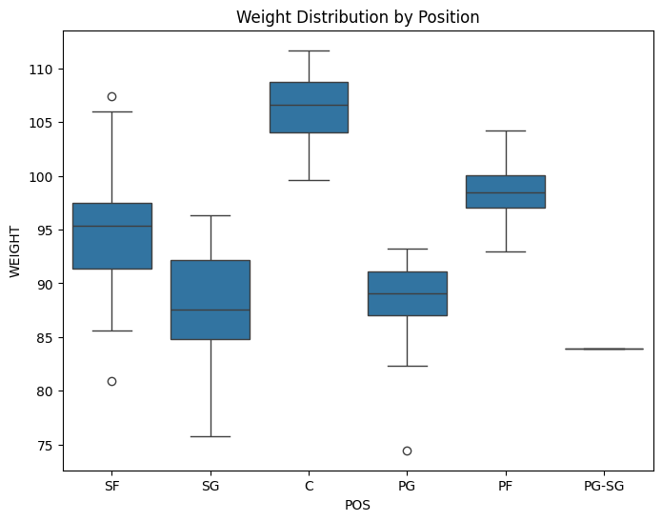
Weight Distribution by Position and Outliers
Small Forward (SF): One outlier is lighter than average, suggesting a focus on agility.
Point Guard (PG): A heavier outlier, indicating increased physicality but potentially lower agility
Center (C): One significantly heavier player, offering greater physical presence

Slide 8
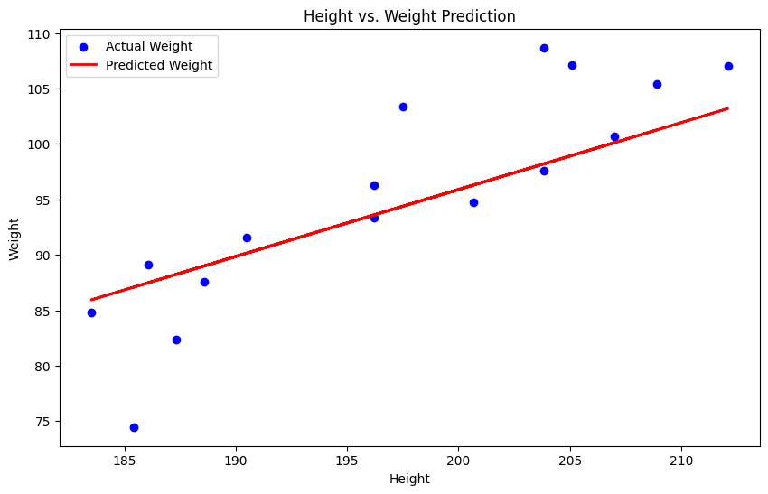
Predictive Model: Player Weight
Using linear regression, we predicted player weight based on height and wingspan.
The model achieved a Mean Squared Error (MSE) of 31.271 in predicting weight.
The model showed that height had a higher impact on weight predictions.

Slide 9
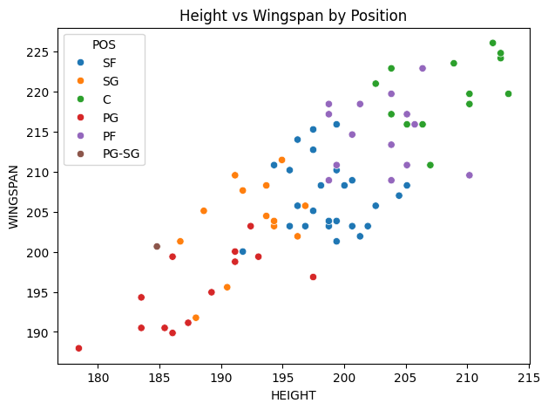
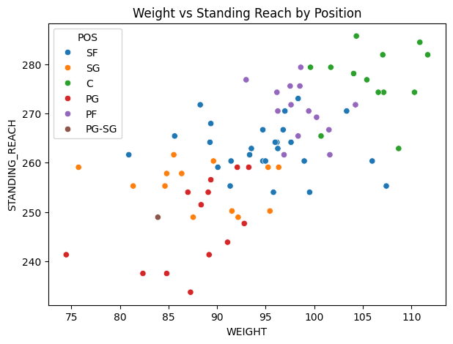
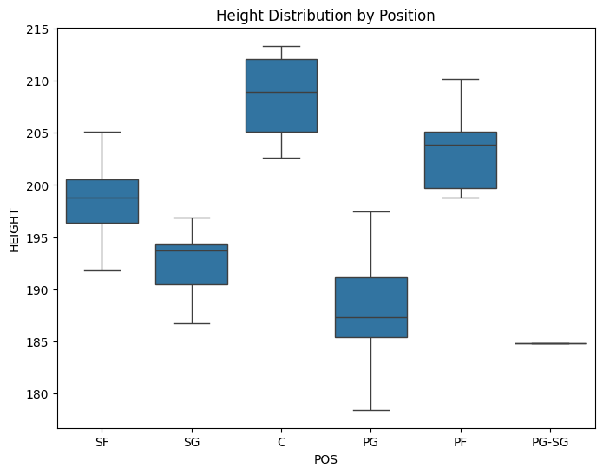
Key Analysis Findings
Height and Position: Taller players, particularly Centers (C) and Power Forwards (PF), have distinct advantages in terms of reach and wingspan, critical for rebounding and defense.
Weight Outliers: Significant weight outliers in the Point Guard (PG) and Small Forward (SF) positions indicate variation in player body types and playing styles.
Correlations: Strong correlations observed between:
Height and Wingspan
Weight and Standing Reach
Height and Player Performance in specific positions

Slide 10
Conclusion and Recommendations
Key Insights:
Taller and heavier players generally perform better in specific positions.
Wingspan and standing reach are crucial for certain player roles.
Recommendation: Future NBA draft evaluations should focus on a
combination of physical measurements and skill performance

Slide 11
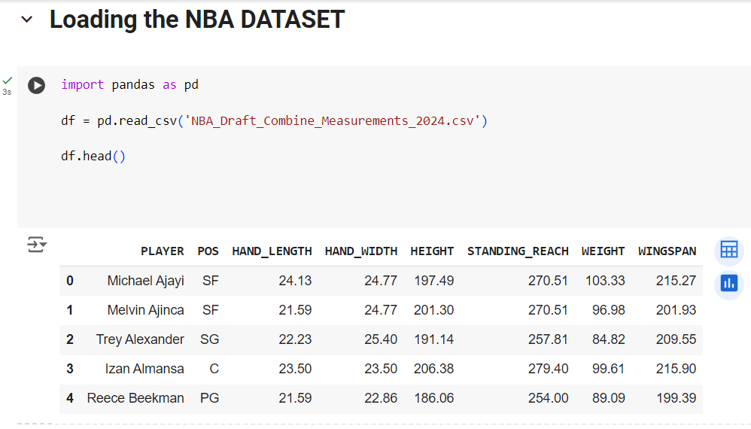

Slide 12
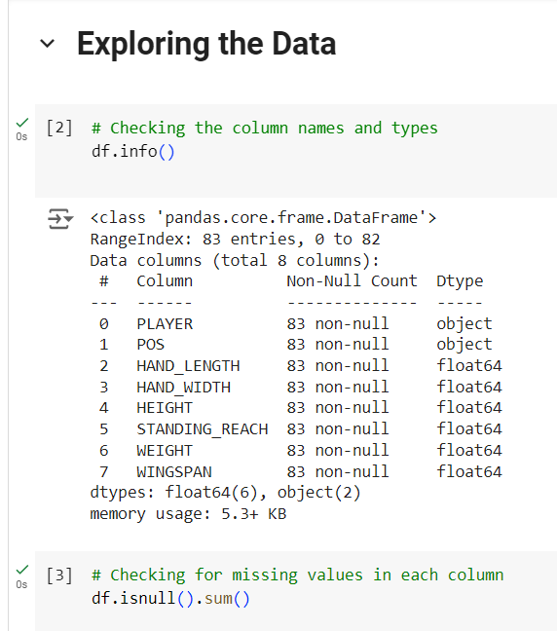

Slide 13
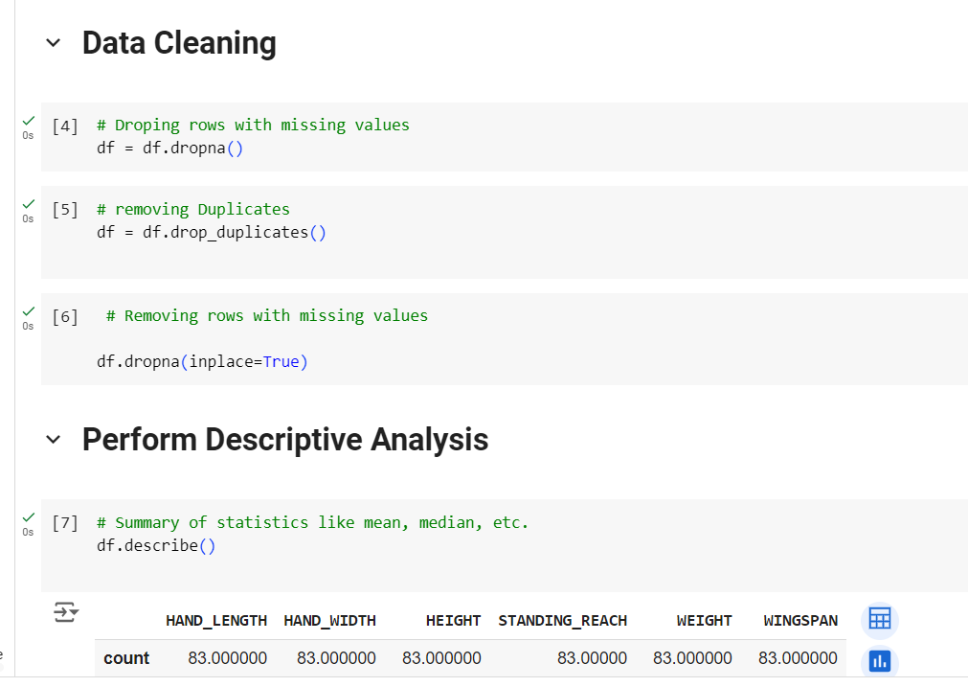

Slide 14
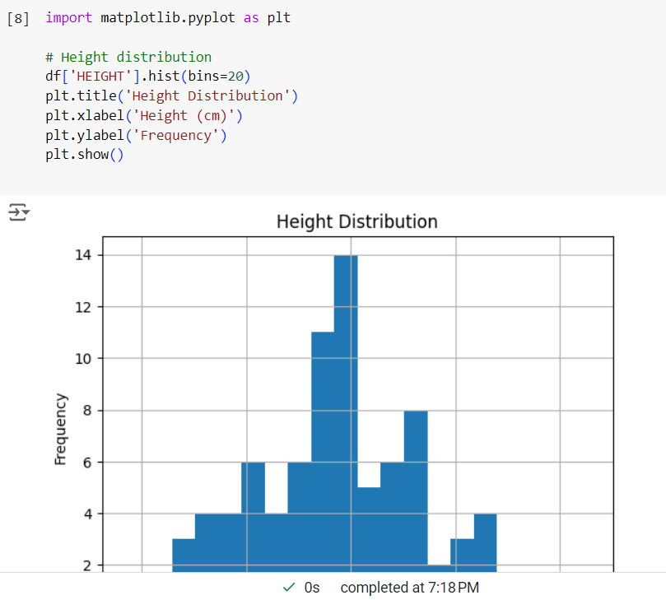

Slide 15
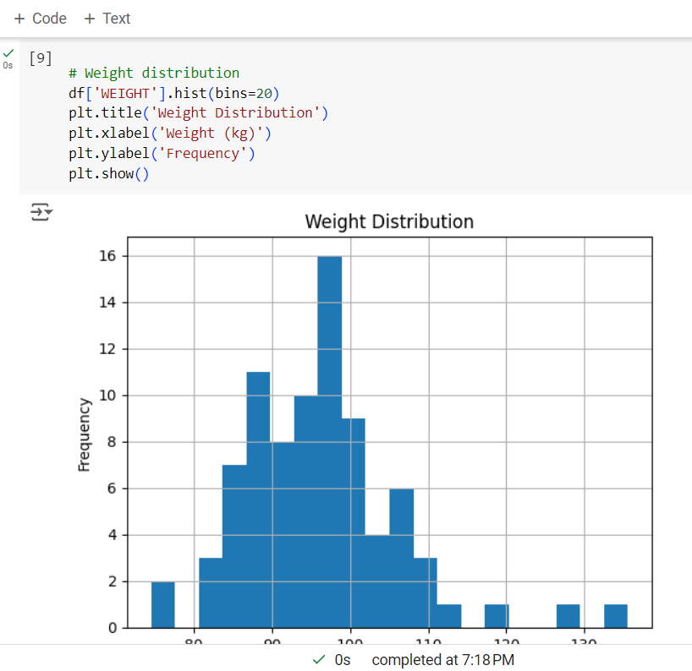

Slide 16
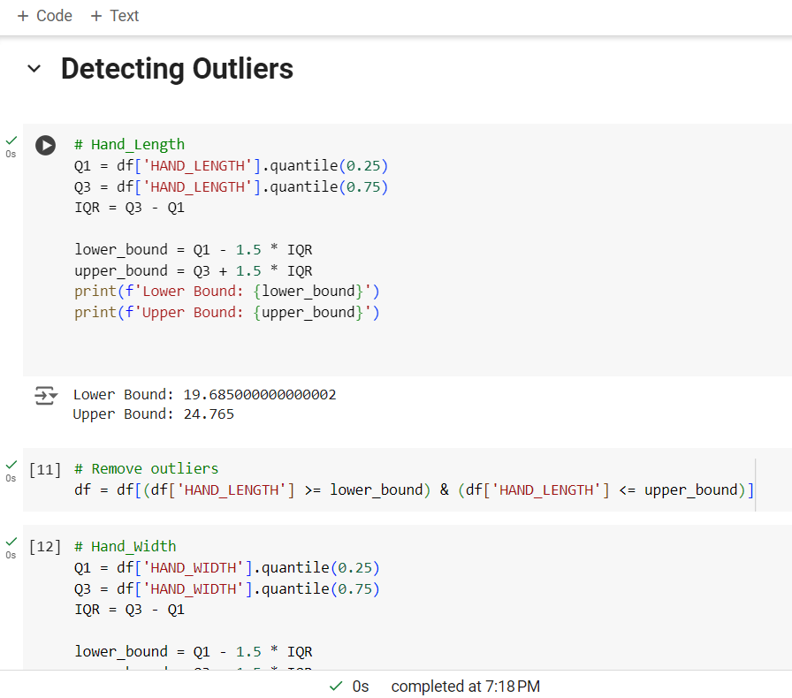

Slide 17
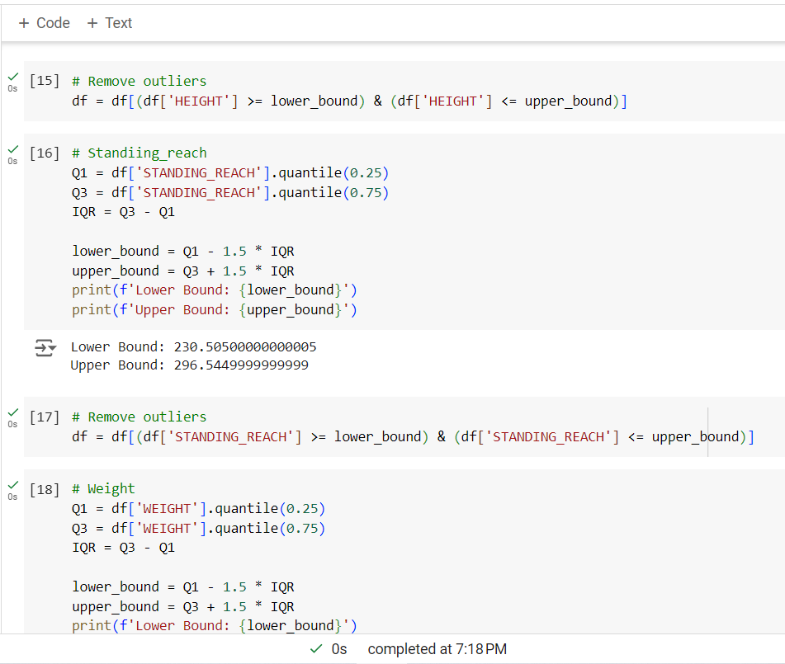

Slide 18
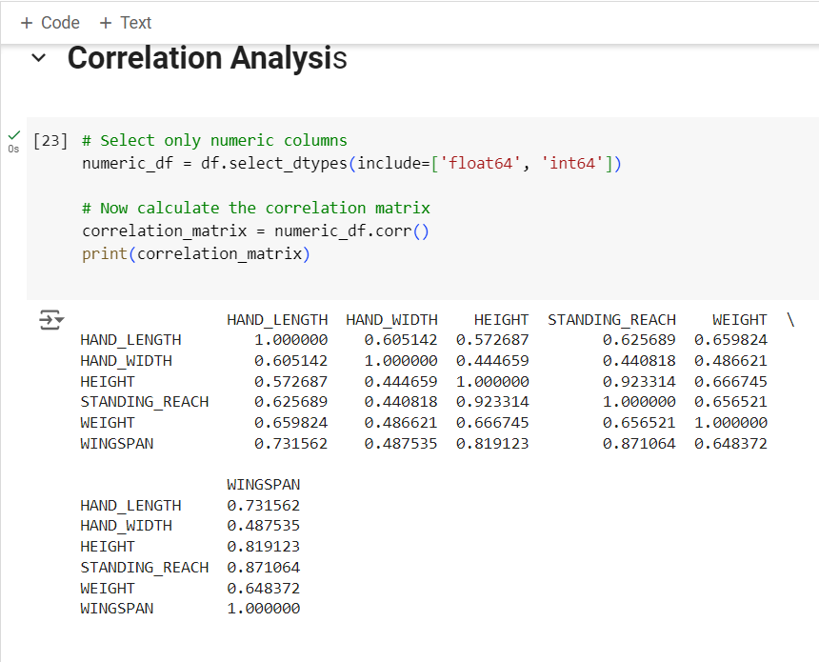

Slide 20
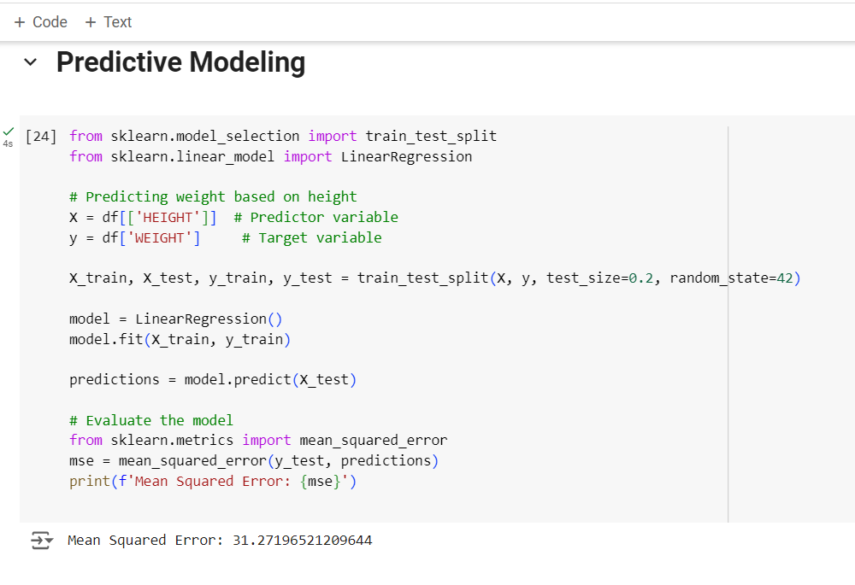

Slide 21
